Slide 1
Algebric Expressions Implementation using Stack
Fakhera Nazir

Slide 2
Applications of Stacks
Some direct applications:
Conversion of tail-recursive algorithms to iterative ones. [Note: Tail recursion will be covered in a later lesson]
Keeping track of method calls: Method activation records are saved on the run-time stack
Evaluation of arithmetic expressions by compilers [infix to postfix conversion, infix to prefix conversion, evaluation of postfix expressions]
Some indirect applications
Auxiliary data structure for some algorithms
Example: Converting a decimal number to another base
Component of other data structures
Example: In this course we will use a stack to implement a Tree iterator

Slide 3
Application of Stacks - Evaluating Postfix Expressions
(5+9)*2+6*5
An ordinary arithmetical expression like the above is called infix-expression -- binary operators appear in between their operands.
The order of operations evaluation is determined by the precedence rules and parentheses.
When an evaluation order is desired that is different from that provided by the precedence, parentheses are used to override precedence rules.

Slide 4
Application of Stacks - Evaluating Postfix Expressions (Cont’d)
Expressions can also be represented using postfix notation - where an operator comes after its two operands
Expressions can also be represented using prefix notation – where an operator comes before its two operands.
The advantage of postfix and prefix notations is that the order of operation evaluation is unique without the need for precedence rules or parentheses.
Prefix (Polish) Notation | Postfix (Reverse Polish) Notation | Infix Notation
/ 16 2 | 16 2 / | 16 / 2
* + 2 14 5 | 2 14 + 5 * | (2 + 14)* 5
+ 2 * 14 5 | 2 14 5 * + | 2 + 14 * 5
* - 6 2 + 5 4 | 6 2 - 5 4 + * | (6 – 2) * (5 + 4)

Slide 5
Infix to Postfix conversion (manual)
An Infix to Postfix manual conversion algorithm is:
1. Completely parenthesize the infix expression according to order of priority you want.
2. Move each operator to its corresponding right parenthesis.
Remove all parentheses.
Examples:
3 + 4 * 5 (3 + (4 * 5) ) 3 4 5 * +
a / b ^ c – d * e – a * c ^ 3 ^ 4 a b c ^ / d e * a c 3 4 ^ ^ * - -
((a / (b ^ c)) – ((d * e) – (a * (c ^ (3 ^ 4) ) ) ) )

Slide 6
Infix to Prefix conversion (manual)
An Infix to Prefix manual conversion algorithm is:
1. Completely parenthesize the infix expression according to order of priority you want.
2. Move each operator to its corresponding left parenthesis.
Remove all parentheses.
Examples:
3 + 4 * 5 (3 + (4 * 5) ) + 3 * 4 5
a / b ^ c – d * e – a * c ^ 3 ^ 4 - / a ^ b c - * d e * a ^ c ^ 3 4
( (a / (b ^ c)) – ( (d * e) – (a * (c ^ (3 ^ 4) ) ) ) )

Slide 7
Application of Stacks - Evaluating Postfix Expression (Cont’d)
The following algorithm uses a stack to evaluate a postfix expressions.
Start with an empty stack
for (each item in the expression) {
if (the item is an operand)
Push the operand onto the stack
else if (the item is an operator operatorX){
Pop operand1 from the stack
Pop operand2 from the stack
result = operand2 operatorX operand1
Push the result onto the stack
}
}
Pop the only operand from the stack: this is the result of the evaluation

Slide 8
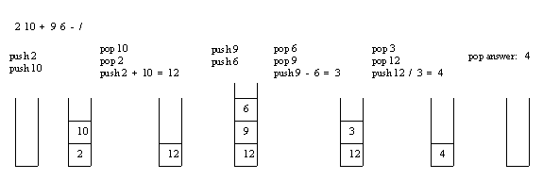
Application of Stacks - Evaluating Postfix Expression (Cont’d)
Example: Consider the postfix expression, 2 10 + 9 6 - /, which is (2 + 10) / (9 - 6) in infix, the result of which is 12 / 3 = 4.
The following is a trace of the postfix evaluation algorithm for the postfix expression:

Slide 9
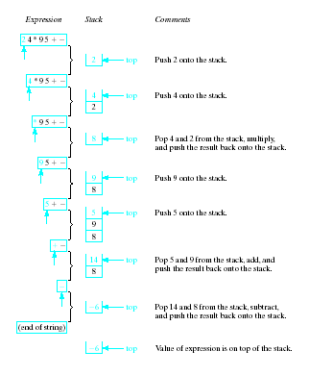
Example Evaluation of Postfix
Note the changing status of the stack

Slide 10
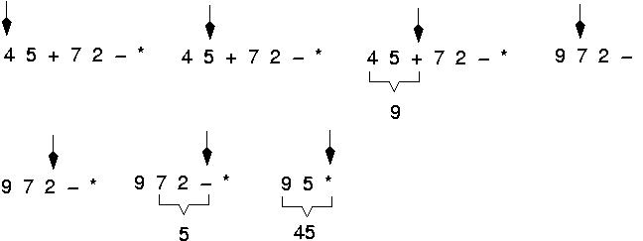
Example: postfix expressions (cont.)

Slide 11
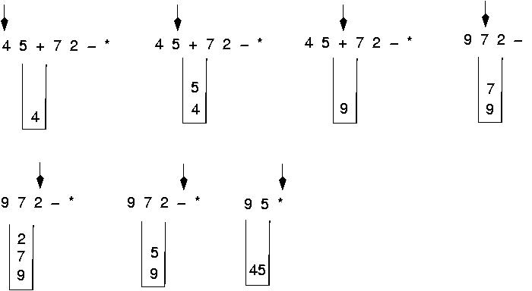
Postfix expressions: Algorithm using stacks (cont.)

Slide 12
Question : Evaluate the following expression in postfix : 623+-382/+*2^3+
Final answer is ??
49
51
52
7
None of these

Slide 13
Evaluate- 623+-382/+*2^3+
Symbol opnd1 opnd2 result STACK
6 6
2 6,2
3 6,2,3
+ 2 3 5 6,5
- 6 5 1 1
3 6 5 1 1,3

Slide 14
Evaluate- 623+-382/+*2^3+
Symbol opnd1 opnd2 result STACK
8 6 5 1 1,3,8
2 6 5 1 1,3,8,2
/ 8 2 4 1,3,4
+ 3 4 7 1,7
* 1 7 7 7
2 1 7 7 7,2
^ 7 2 49 49
3 7 2 49 49,3
+ 49 3 52 52

